Slide 1
The Emergency Food Assistance Program
Illinois Department of Human Services
Civil Rights Non-Discrimination
&TEFAP Training

Slide 2
Acknowledgement
I want to THANK YOU for all you do to help the people in your community not to go hungry.
The past 2 years have been tough years but the food banks and you the pantries have persevered and done amazing work.
We want to let you know that your work has not gone unnoticed. Because of all of you we could not do what we do without all of you.
Thank you once again !!

Slide 3
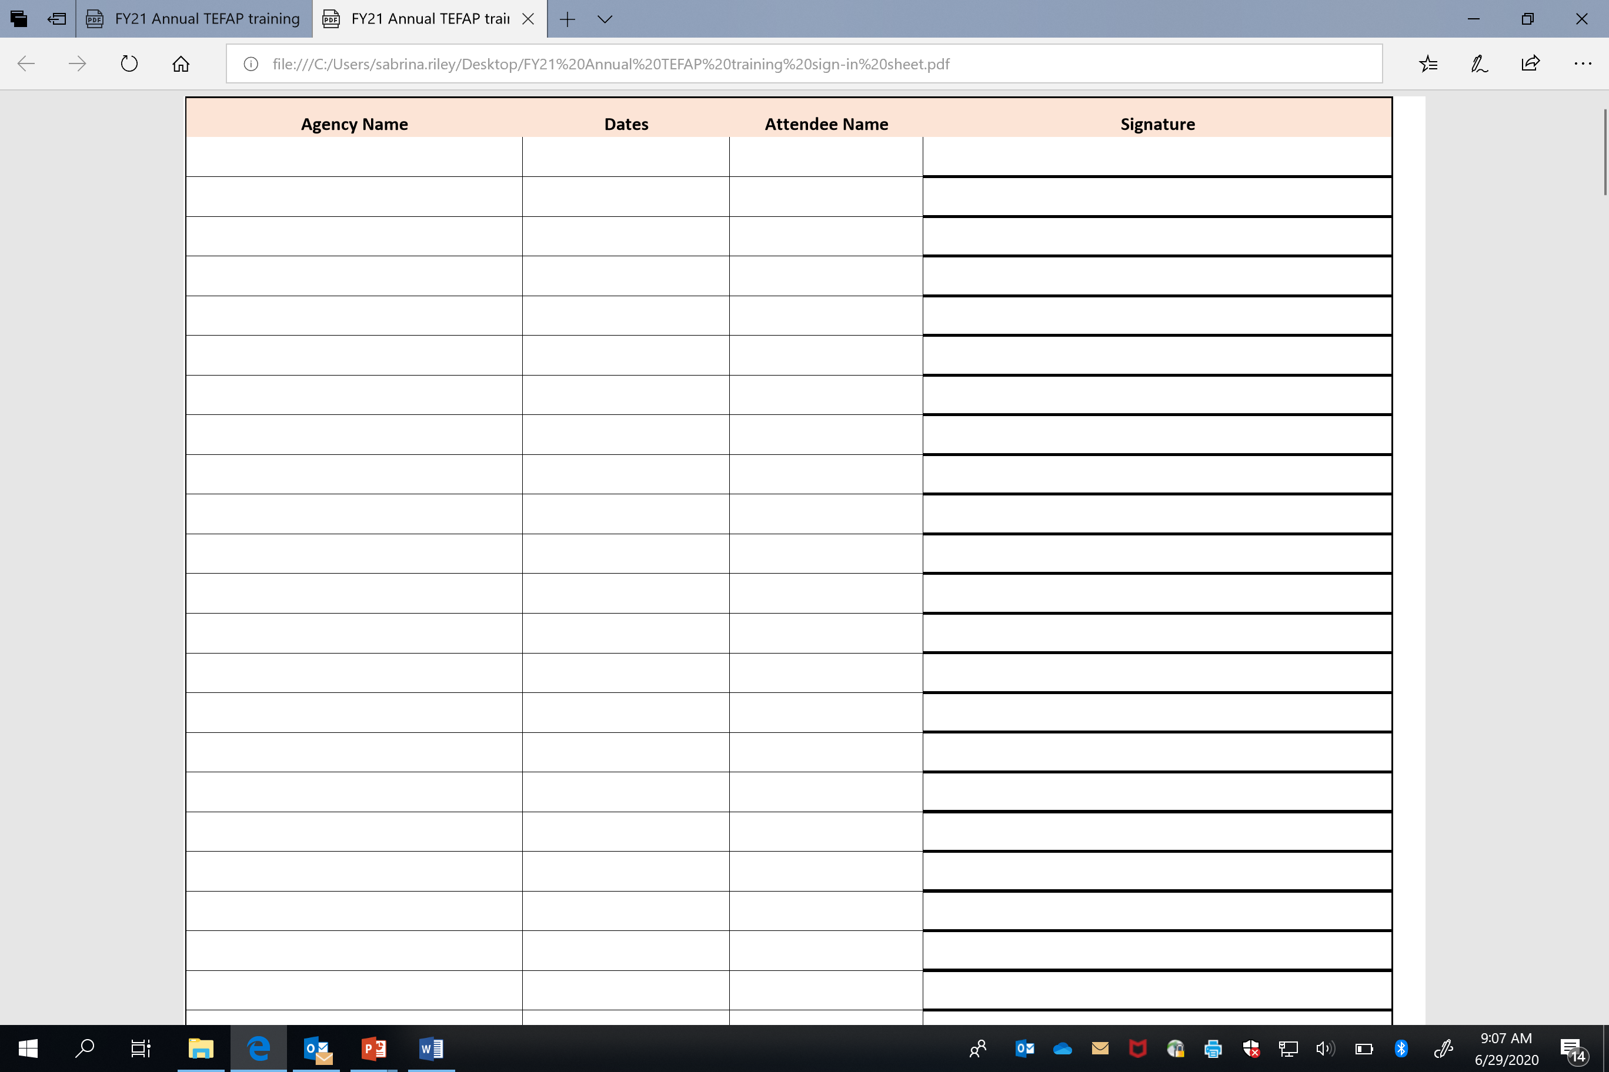
Training Signature Sheet
Signing the signature will be verification you have received training.
Please everyone sign the signature sheets for your Foodbank

Slide 4
Introduction
Introduction
Tallett Vanek
Program Manager
Lisa Flynn ( Contractor )
Program Coordinator / Monitor
Latanya Alexander
TA Program Coordinator/Monitor
Vacant
Pantry Monitor
Britney Southard
Office Coordinator

Slide 5
USDA Civil Rights & Non-Discrimination Training
Purpose
To convey policy and provide guidance to ensure compliance and prohibit discrimination
The following training material is derived from:
Code of Federal Regulations Parts 210 and 24
USDA’s Food and Nutrition Service Instruction 113-1

Slide 6
USDA Civil Rights & Non-Discrimination Training
Training
Civil Rights Training is required for all staff on an annual basis
Training must be documented and kept on file by the food bank and sent to DHS/TEFAP Manager
Topics to be covered in the food bank training for staff should include:
Effective public notification
Complaint Procedures
Compliance review techniques
Resolutions of noncompliance
Requirements for reasonable accommodations for persons with disabilities
Requirements for language assistance
Conflict resolution
Customer Service

Slide 7
USDA Civil Rights & Non-Discrimination Training
What is Discrimination ?
The act of distinguishing one person or group of persons from others, either intentionally, by neglect, or by effect of actions or lack of actions based on their protected bases

Slide 8
USDA Civil Rights & Non-Discrimination Training
6 Protected Bases / Classes
Race
Color
National Origin
Sex
Disability
Age

Slide 9
USDA Civil Rights & Non-Discrimination Training
Six Areas of Civil Rights Compliance
Public Notification
Data Collection
Annual Training
Compliance Reviews
How to recognize and handle Civil Rights Complaints
Assurances - language, contracts and forms that you and others will not participate in discrimination and report any complaints

Slide 10
USDA Civil Rights & Non- Discrimination Training
Public Notification
The purpose of this system is to inform applicants, participants, and potentially-eligible persons of:
Program Availability
Program Rights and Responsibilities
The Policy of Nondiscrimination
The Procedure for Filing a Complaint

Slide 11
USDA Civil Rights & Non- Discrimination Training
Elements of Public Notification
State agencies and their subrecipients must:
Make program information available to the public upon request
Prominently display the “And Justice for All” poster
Inform potentially eligible persons, applicants, participants and grassroots organizations of programs or changes in programs
Convey the message of equal opportunity in all photos and other graphics that are used to provide program or program-related information
Provide appropriate information in alternative formats for persons with disabilities and in the appropriate language(s) for LEP persons

Slide 12
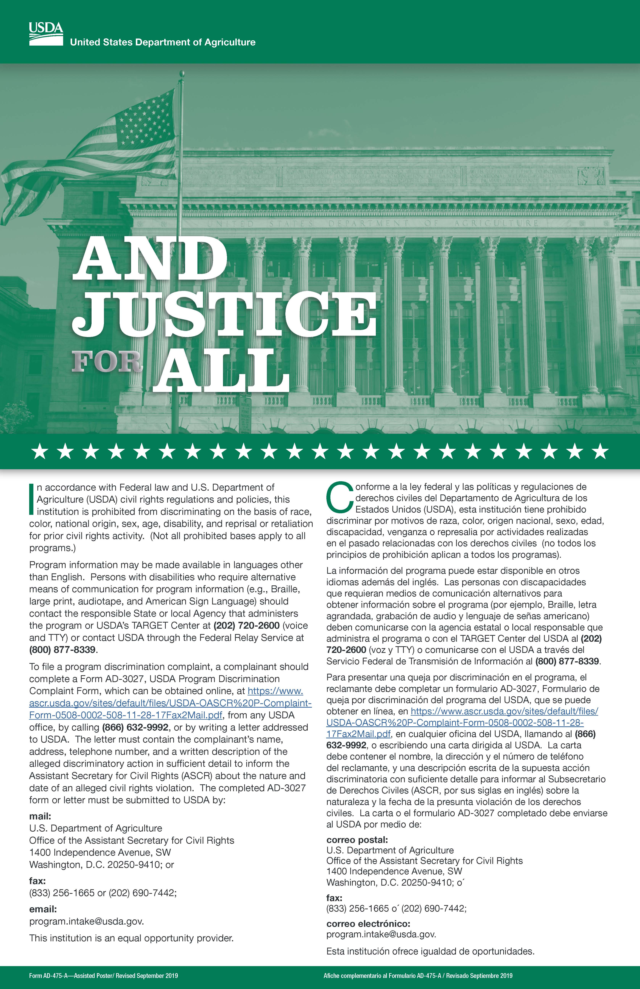
USDA Civil Rights & Non-Discrimination Training
“ And Justice for All” Poster
Poster is part of the public notification process and provides participant rights and responsibilities as well as information on filing a Civil Rights complaint.
Poster must be posted in a prominent location at the point of service and visible to all program volunteers and participants.

Slide 13
USDA Civil Rights & Non-Discrimination Training
Non–Discrimination Statement
In accordance with Federal civil rights law and U.S. Department of Agriculture (USDA) civil rights regulations and policies, the USDA, its Agencies, offices, and employees, and institutions participating in or administering USDA programs are prohibited from discriminating based on race, color, national origin, religion, sex, gender identity (including gender expression), sexual orientation, disability, age, marital status, family/parental status, income derived from a public assistance program, political beliefs, or reprisal or retaliation for prior civil rights activity, in any program or activity conducted or funded by USDA

Slide 14
USDA Civil Rights & Non-Discrimination Training
The non-discrimination statement must be printed on all public material in accordance with the federal civil rights law and the US Department of agriculture civil rights regulations and policies.

Slide 15
USDA Civil Rights & Non-Discrimination Training
Limited English Proficiency (LEP)
Must take reasonable steps to provide program information, materials and services to persons with limited English proficiency.
Failure to do so or denying them access to the program could be considered discrimination based on national origin.
The USDA has a broad range of resources to assist with LEP individuals per program availability rights and responsibilities.
The USDA FNS website provides translated material in multiple languages, including the “And justice for all” poster.
Please check the USDA FNS website for additional resources.
www.fns.usda.gov/tefap
Phone number for translation (800) 843-6154 English or Español

Slide 16
I Speak Resource

Slide 17
USDA Civil Rights & Non-Discrimination Training
Recognizing a Civil Rights Discrimination
Complaint
Can be Verbal or written
Must be discrimination based on one or more of the 6 protected classes
Can be made to any staff member or volunteer at the food bank, pantry, DHS or the USDA
Follow the correct complaint process and procedure

Slide 18
USDA Civil Rights & Non-Discrimination Training
To file a program discrimination complaint, complete the USDA Program Discrimination Complaint Form, AD-3027, found online at How to File a Program Discrimination Complaint and at any USDA office or write a letter addressed to USDA and provide in the letter all of the information requested in the form. To request a copy of the complaint form, call (866) 632-9992. Submit your completed form or letter to USDA by: (1) mail: U.S. Department of Agriculture, Office of the Assistant Secretary for Civil Rights, 1400 Independence Avenue, SW, Washington, D.C. 20250-9410; (2) fax: (202) 690-7442; or (3) email: program.intake@usda.gov.

Slide 19
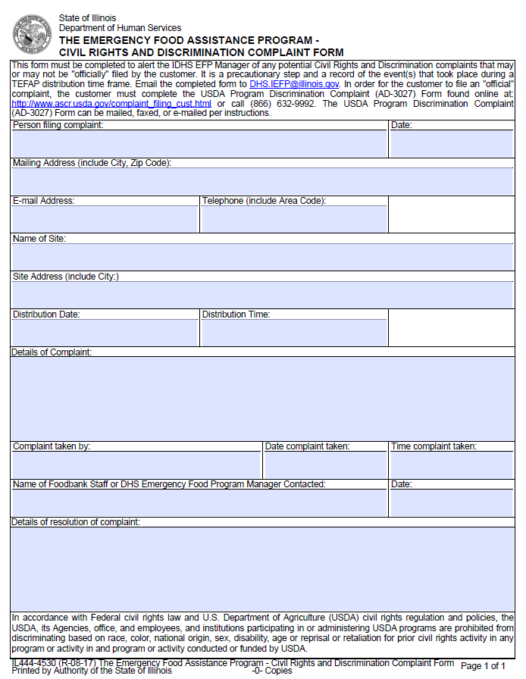
USDA Civil Rights & Non-Discrimination Training
Civil Rights Discrimination Complaint
If a Distribution Site suspects that a
customer is
unsatisfied with the services provided, for
whatever reason, …
State of Illinois
THE EMERGENCY FOOD ASSISTANCE PROGRAM –
CIVIL RIGHTS AND DISCRIMINATION COMPLAINT FORM
Form Number IL444-4530

Slide 20
USDA Civil Rights & Non-Discrimination Training
Conflict Resolution Components
Control emotional responses
Seek understanding
Identify need and common interests
Seek mutual benefits or purpose

Slide 21
USDA Civil Rights & Non-Discrimination Training
Constructive Conflict Resolution
Define the problem/issue/complaint
Identify the activity causing conflict and assess the details of the information provided
Recognize, respect and respond to the feelings of those involved in the conflict
Resolution

Slide 22
USDA Civil Rights & Non-Discrimination Training
Keys to Good Customer Service
Recognize customers have varied needs and few resources.
Recognize when a customer feels they have been treated in a rude or discourteous manner
Learn to practice empathy when necessary
Develop good listening skills

Slide 23
TEFAP & TANF Food Distribution
WHAT IS
TEFAP?

Slide 24
TEFAP & TANF Food Distribution
What is TEFAP?
The Emergency Food Assistance Program
Congress passed the TEFAP Act in May 1983
TEFAP is a Federal program that helps supplement the diets of low-income and food insecure individuals at no cost
TEFAP provides USDA commodities to agencies who voluntarily participate in this program
Thanks to workers and volunteers across Illinois, TEFAP provides an emergency response to hunger throughout the State

Slide 25
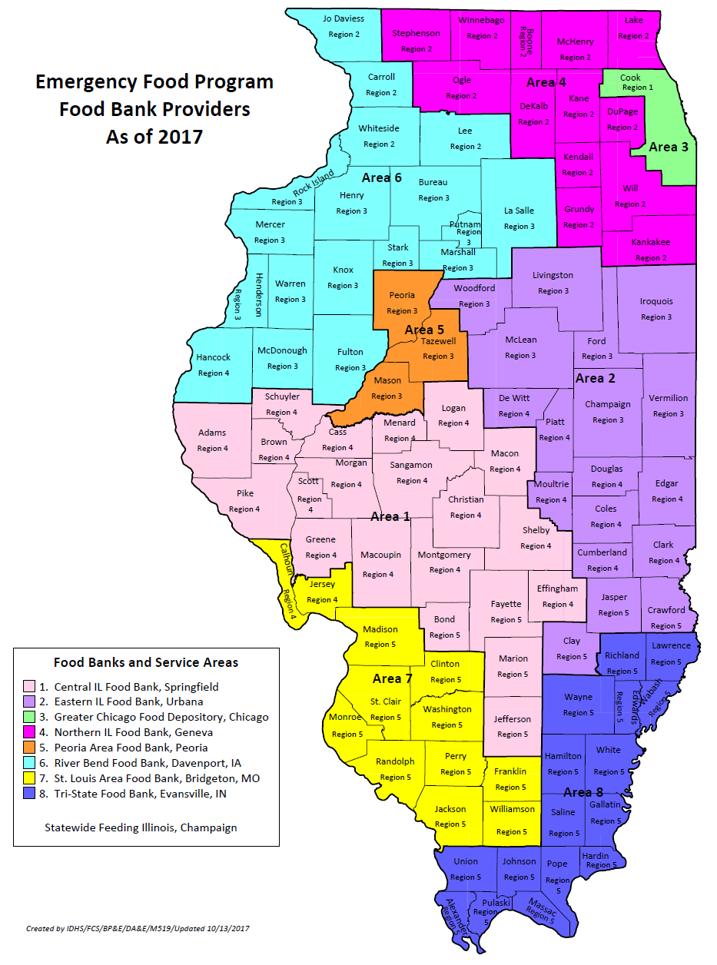
8 Food Banks:
Central Illinois Food Bank
Eastern Illinois Food Bank
Greater Chicago Food Depository
Northern Illinois Food Bank
Peoria Area Food Bank
River Bend Food Bank
St. Louis Area Food Bank
Tri-State Food Bank
Currently there are 680 Food
Distribution sites throughout Illinois

Slide 26
TEFAP & TANF Food Distribution
FY22 Accomplishments :
Households Served = 2,366,141
Pounds of Food Distributed = 51,832,924
Individuals Served = 5,909,077
FY22 Accomplishments : ( As of February 2023)
Households Served = 1,749,004
Pounds of Food Distributed = 24,974,666
Individuals Served = 4,937,158

Slide 27
TEFAP & TANF Food Distribution
WHAT IS
TANF?

Slide 28
TEFAP & TANF Food Distribution
Temporary Assistance for Needy Families
TANF program created by the Personal Responsibility and Work Opportunity Act in 1996
Special funds for the purchase of additional food for families with children 18 or younger, which includes items like cereal, peanut butter and milk
Food Bank Purchasing is usually from March through June
Distribution is usually from June through August
Prior to distribution of TANF food, the number of children must be entered on the Signature Sheet or Proxy Form

Slide 29
TEFAP & TANF Food Distribution
WHAT IS
SNAP?

Slide 30
TEFAP & TANF Food Distribution
What is SNAP?
Supplemental Nutrition Assistance Program
IDHS administers SNAP in the State of Illinois
IDHS Customer Help Line: 800-843-6154
Eligible applicants receive food assistance benefits, which are automatically transferred to an electronic card: Illinois Link Card
Documented on the last column of the Signature Sheet
Do you receive SNAP? (Check yes or no)

Slide 31
What is WIC?
What is Summer Lunch or After School Meals?

Slide 32
TEFAP & TANF Food Distribution
Distribution
documentation

Slide 33
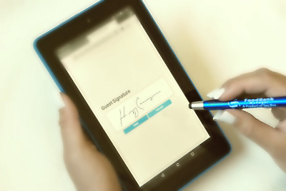
Distribution Documentation
Signature Sheets
E-Signature
Proxy Forms
Proofread all Signature Sheets and Proxy Forms for accuracy and completeness
Submit the original signature sheet to the food bank monthly

Slide 34
Signature Sheets
Must be signed prior to distribution or waived
signature in L2F or SIMC platform
Household size
How many living in household?
How many individuals are consuming the
TEFAP/TANF food?
Address, City
Can state “none” if recipient is homeless
# Children in household 18 years or younger
Do you receive SNAP? (Check yes or no)
Submit all original Signature Sheets and Proxy
Forms each month to the Food Bank by the
10th of each month, if applicable

Slide 35
Proxy Form
“Proxy” is the person picking up and
delivering food for another individual
Proxy form is valid indefinitely unless the
designated proxy individual changes
Customer completes, signs & dates
the Proxy Form
Proxy takes the form to the pantry
Proxy signs & dates the form while
at the pantry
Pantry staff sign & date the form
ALL SIGNATURES (3 total) & ALL DATES
ARE REQUIRED

Slide 36
TEFAP & TANF Food Distribution
ELIGIBILITY
REQUIREMENTS

Slide 37
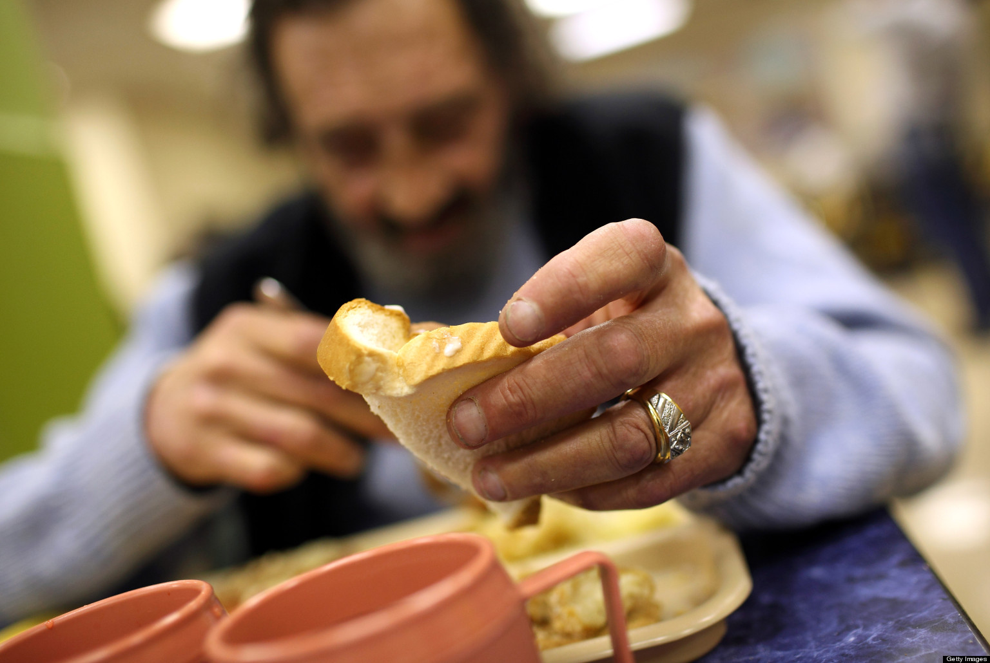
Eligibility Requirements
Customers must not be asked to prove eligibility
Anyone eating at a soup kitchen or shelter is assumed to be eligible for service

Slide 38
Proof of Income
Self-attestation/Self-declaration is the accepted means of documenting income eligibility
The term Self Attestation indicates to certify that a document is true, correct or genuine by signing. A self-declaration is a statement made by a person declaring that all the statements of facts, figures and circumstances mentioned in a document is true and correct. Distribution Sites are prohibited from verifying income
Distribution Sites are NOT ALLOWED to ask for
social security cards, pay stubs or income data
for the distribution of TEFAP foods.

Slide 39
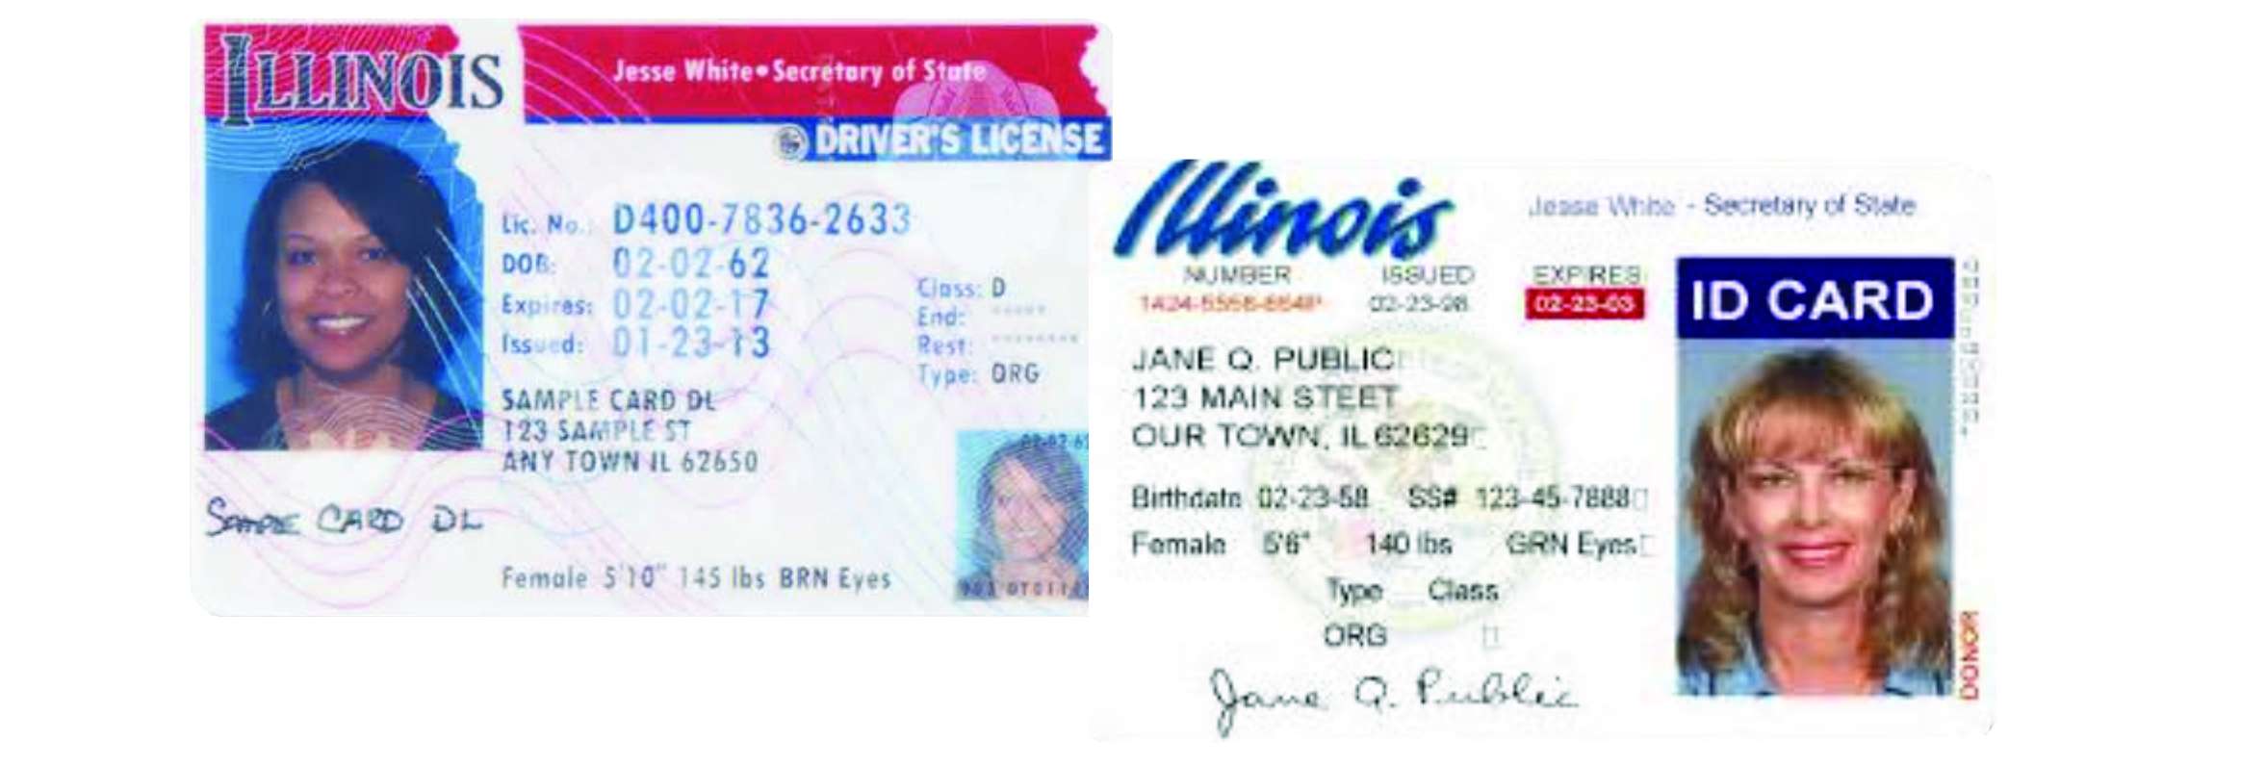
Proof of Identity & Residency
Documentation that can be verified are:
Driver’s License
State ID Card
Mail such as utility bill or letter from landlord
If you request an ID from one person then you must request
from EVERYONE!

Slide 40
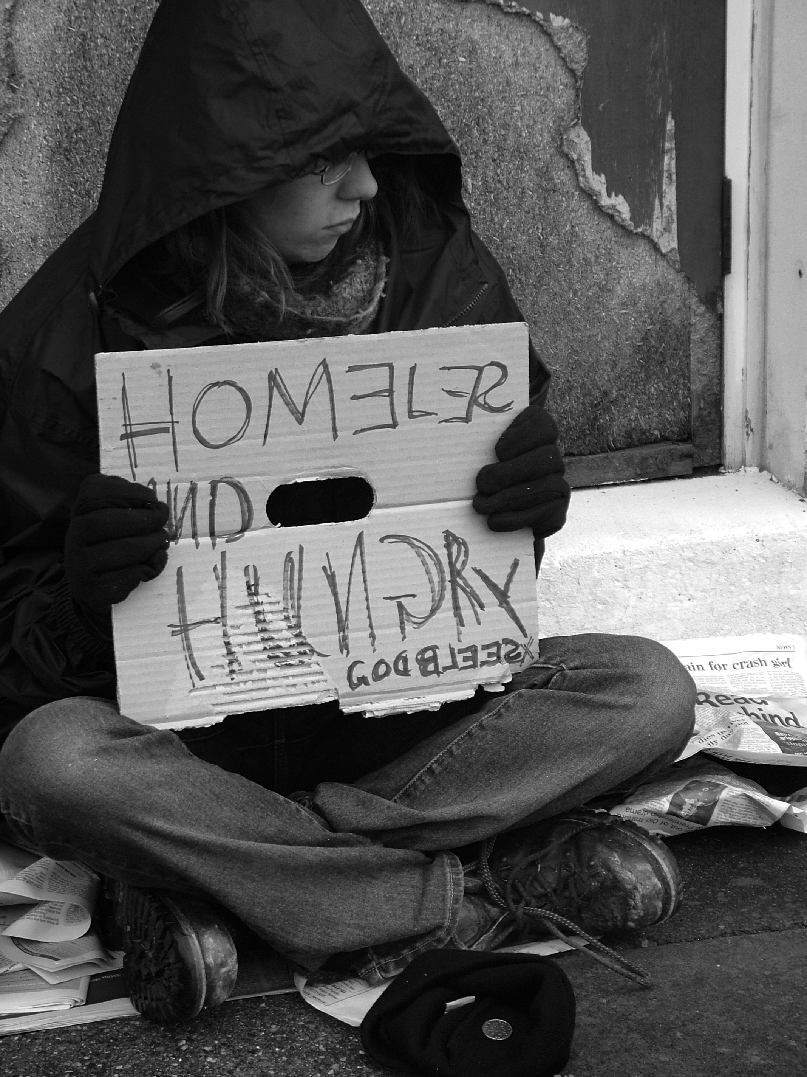
Serving Homeless Recipients
Self-attestation by homeless recipients
must be accepted
Homeless persons or persons with
disabilities may lack documentation
to verify their identity or residence
Distribution Site may indicate “NONE” in
the address section of the Signature
Sheet/Proxy Form

Slide 41
TEFAP & TANF Food Distribution
Temporary Amendments to Documentation and Eligibility
Signature requirement suspended
Income eligibility increase from 185% to 300% (waiting on USDA approval).

Slide 42
TEFAP & TANF Food Distribution
FOOD PANTRIES

Slide 43
Food Pantries
Open at least 2 hours per week
Must display operating days and times
Must be open during established times
May not require appointments
Eligible customers entitled to service at least once every 30 days
May not charge fees or require memberships
Documentation to include signature sheets / proxy forms
Must distribute EFP in combination with other foods distributed
May not be distributed separately

Slide 44
TEFAP & TANF Food Distribution
HOMELESS SHELTERS AND SOUP KITCHENS

Slide 45
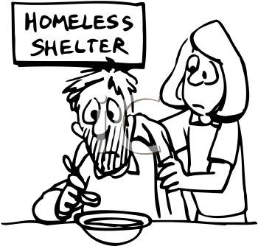
Homeless Shelters & Soup Kitchens
Serve meals at least 2 hours per week
Must post meal-service schedule
Must count every meal served
Count additional helpings as individual meals and add to total #
Not reporting all meals served could result in reduction of commodities
Document how total meals were computed each month
i.e., sign-in, plate counting, etc.
Submit monthly reports to Food Bank for total meals served
If Pantry operates as a soup kitchen also make sure the food is properly separated and tracked as two programs

Slide 46
TEFAP & TANF Food Distribution
REQUIRED POSTERS

Slide 47
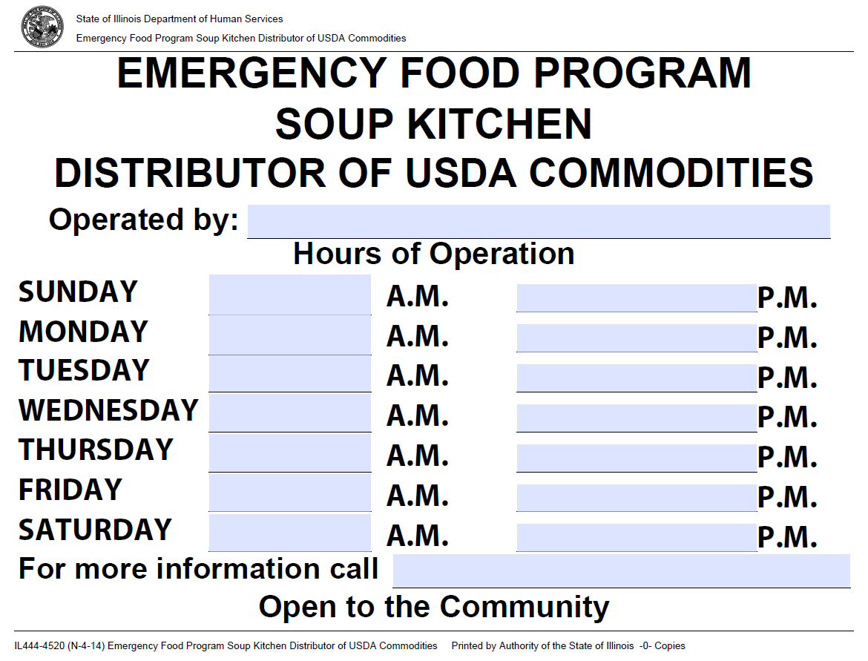
Required Posters
Hours of Operation
Notifies recipients of days
& hours of operation
Provided by TEFAP
Must be posted where it can
be easily seen
In addition to the posters use
public outreach to make
individuals aware of your
services

Slide 48
Required Posters
Income Eligibility Guidelines
Lists maximum allowable monthly
gross income for household sizes
Updated annually
Provided by TEFAP/USDA
Illinois is currently waiting on approval
for TEFAP eligibility percentage.

Slide 49
Required Posters
“And Justice For All”
Instructs the customer on what
action to take in case of discrimination
or Civil Rights violation
Provided by TEFAP/USDA

Slide 50
Required Posters
Notice to Program Participants
Conditions customer agrees to
by signing the Signature Sheet:
Household gross income
Household consumption
Release from liabilities
Provided by TEFAP

Slide 51
Required Posters
Prohibited Activities
Lists activities that violate TEFAP
regulations
Donations
Payment for services
Purchase for a good cause
Politics
No fees
Food cannot be sold
Instructs the customer on what
action to take
Provided by TEFAP

Slide 52
Required Posters
Written Notice of Beneficiary Rights
Notification that customer can
receive a referral to another pantry,
soup kitchen or shelter if there is a
religious character conflict
Provided by TEFAP

Slide 53
Required Posters
All Posters must be in plain view for all recipients.

Slide 54
TEFAP & TANF Food Distribution
FOOD STORAGE & SAFETY

Slide 55
Food Storage & Safety
Sites must comply with State and local laws, policies, procedures and warehousing standards
Food must be stored in a manner to protect from spoilage, infestation, damage or other conditions that may jeopardize the safety of foods
The receipt of damaged, spoiled, infested USDA commodities must be reported to the Food Bank

Slide 56
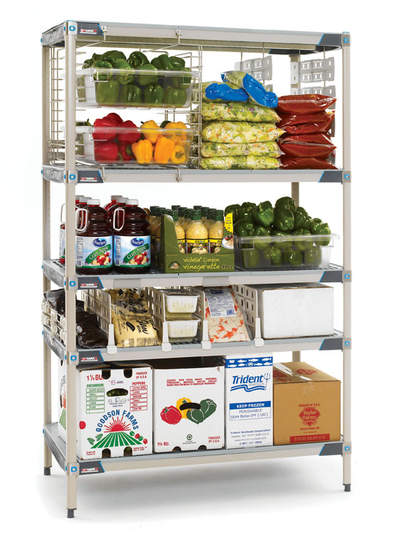
Food Storage & Safety
Thermometer
Refrigerate between 35° F and 40° F
Freeze below 0° F
FIFO
Dry and refrigerated commodities must
be rotated to ensure the quality and freshness
Packaging
Dented cans can be used unless you
notice any of the following:
Bulged can, leakage, damaged seals, rust

Slide 57
Food Storage & Safety *Will be inspected during monitoring
Storing Refrigerated & Frozen Commodities
All cold units must:
Have a thermometer
Be cleaned & inspected
Allow for proper air circulation
Refrigeration temp 35° to 40° F
Freezer temp below 0° F
Storing Dry Commodities
Store in a dry, cool place
Store away from sunlight
2 foot ceiling clearance
At least 6” off floor
At least 4” from walls
Keep floor, pallets, storage and shelving clean
Keep non-food items separate from food
Pest Control Log

Slide 58
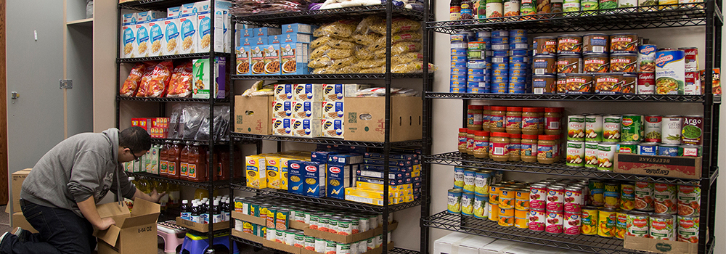
Food Storage & Safety
Expiration & Use-By date
Do not use or distribute food when not fit for human consumption, regardless of product dates or when food received
Quality Control – Conditions to report to Food Bank:
Quality issues (odors, appearance)
Foreign material in product (bones, metal)
Poor packaging (split bags, leaking, rusty or bulging cans)

Slide 59
Product End Dates
Best if Used By Date or Best if Used Before – This date is a date for the best flavor or quality.
Use by Date is the last date a manufacturer recommends for the peak quality
Sell by Date is also a product quality indicator and is the date that the manufacturer recommends the store sell the food product
All of the dates can appear on a retail or donated food products; However these dates are not directly related to food safety.

Slide 60
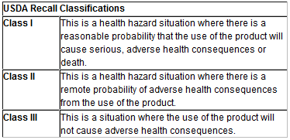
Holds and Recalls
Food Recalls will be monitored by the TEFAP Program Manager, Tallett Vanek
The TEFAP Manager will be backed up by the other TEFAP personnel
In the event of a Food Recall the program Manager will notify the Food Banks and in turn the Food Banks will notify the pantries of any foods that may be recalled and what actions needs to be taken for the recalled food

Slide 61
TEFAP & TANF Food Distribution
MONITORING & SITE INSPECTIONS

Slide 62
Monitoring and Site Inspection
All program staff and volunteers must be informed that Food Bank, USDA and IDHS inspectors have the authority to inspect food storage and distribution facilities
Denying an inspector access or not being in compliance with rules and regulations may result in loss of USDA commodities

Slide 63
Monitoring & Site Inspections
Register days & hours of operation
Notify Food Bank of any changes
Open to general public
No appointments allowed
Open at least 2 hours per week
Does not apply to the 2 hours of operation:
ON-call or emergency times, Food prep, cleanup or restocking

Slide 64
Monitoring & Site Inspections
General Questions the monitor will ask
Number of clients served a month general average
If you are under an rural exemption
This a special operating procedures which allows limited hours of operation that may be approved to allow the effective distribution of TEFAP to sparsely populated rural areas
Service Area of your pantry
If you serve customers outside of your area
EFP manual accessible to pantry staff

Slide 65
Monitoring & Site Inspections
General Questions the monitor will ask
Pest Control Log and Name of Pest Control Company
Thermometers in Refrigerators and Freezers
Temperature Log of The Refrigerators and Freezers
Does the site require documentation for the individual?
Does the site require individuals to obtain a referral from an outside agency in order to receive TEFAP foods?
Do individuals need an appointment?
Are USDA Commodities distributed with donated foods?

Slide 66
Thank You

